Slide 1

Introduction to Computer Systems
MIPS Assembly Language - Part 2
Direct Link to view these slides on Google Docs

Slide 2
What to expect in this topic:
What does assembly do?
How does assembly work?
Addressing formats
Branch instructions introduction and comparisons, including if, if/else, for and calling methods

Slide 3
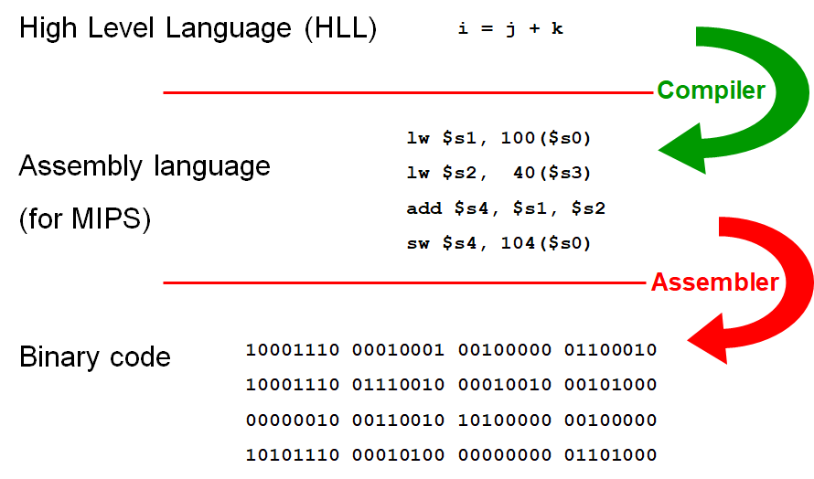
What happens below your program? - revisited
- The compiler decides where in memory to store variables
- Converts high level language into assembly language
- Assembler produces machine code to one to one correspondence between assembly language statements and machine language instructions

Slide 4
Assembler - What does it do?
Converts single line of assembly language to single machine instruction (usually)
Converts symbolic addresses to machine addresses
ld $s0, sum #load immediate the sum value in register s0
ld $s1, temp #load immediate the temp value in register s1
add $s0,$s0,$s1 # add s0 + s1 in s0
….
Easier to understand than
ld $s0, 48($gp) #load contents of address in the register $gp + 48 in register s0
ld $s1, 16($fp)
add $s0,$s0,$s1
….

Slide 5
Assembler - How?
Allows programmer to give symbolic names to locations in RAM
sum: .word 42 # initialises 32 bit word to an integer value 42
Allows storage to be reserved for variables in RAM
average: .space 4 # reserves 4 bytes
Separates instructions and data
.text # starts code section
Instructions (your code after text)
.data # starts data segment
Selects appropriate machine instruction
add $s1,$s2,$t0 # add instruction
addi $s1,$s2,572 # addi instruction
# adds a register and a sign-extended immediate
# value and stores the result in a register

Slide 6
Assembler - More
Historically, assemblers converted 1 assembly language instruction to 1 machine language instruction
MIPS Assembler slightly more complex
– More addressing formats
– Some instructions expand to more than 1 machine instruction
More addressing formats

Slide 7
Addressing Formats
Machine instructions (machine language) only support
ld rx,c(ry)
where: rx and ry are registers, and c is a 16 bit offset
Assembler (assembly language) supports
ld rx,N # N integer
ld rx,imm(ry)
ld rx,(ry)
ld rx,label # label is the address of a location
ld rx,label±imm
ld rx,label±imm(register)
rx and ry are registers, imm is a 16 bit offset and

Slide 8
Addressing Formats
Some of those assembler addressing formats expand to more than one machine language instruction
Many of these expanded instructions use register 1 ($at) as workspace
- $at (Assembler Temporary) register is generally reserved for use in
pseudoinstructions.
For example:The instruction to load a word from the location first
lw $s1, first
Actually generates two machine instructions:
One instruction to load the address of the data segment into register $1($at)
lui $at, 4097 # load upper 16 bits immediate
Another to load register $s1 with a displacement
lw $s1, 0($at) # offset = 0

Slide 9
Branching Instructions
All architectures have operations to alter the flow of control so that a different next instruction is executed
MIPS branch instructions specify an offset in instructions to the next instruction
Example:
beq $s1,$s2, skip # branch if equal, if s1=s2 then goto skip
add $t1,$t2,$t3 # the assembler will not execute add if s1=s2
skip: sub $t1,$t1,$s1
Notes:
1- Skips add instruction if $s1 equals $s2 (executes sub only)
2- Both add and sub instructions will executed if $s1 not equals $s2

Slide 10
Branching Instructions
Comparing two registers
beq $r1,$r2,label # branch if equal
bne $r1,$r2,label # branch if not equal
Comparing a register with zero
bgez $r1,label # branch if greater or equal to 0
bgtz $r1,label # branch if greater than 0
blez $r1,label # branch if less or equal to 0
bltz $r1,label # branch if less than 0

Slide 11
HLL constructs If statement:
There are many ways to express high level language constructs in assembler such as:
if( a >= b ) {
…
}
Might have translation
lw $t1,a # put a in register t1
lw $t2,b # put b in register t2
sub $t1,$t1,$t2 # t1 = a - b
bltz $t1, skip # branch if less than 0 (b > a)
…
…
skip:

Slide 12
HLL constructs If/Else statement:
if( a >= b ) { …}
else { … }
Might have translation
lw $t1,a # put a in register t1
lw $t2,b # put b in register t2
sub $t1,$t1,$t2 # t1= a - b
bltz $t1, else # branch if less than 0 (b > a)
…
j end # unconditional branch is a j ump
else:
…
end:

Slide 13
HLL constructs For statement:
for( j = 0; j < k; j++ )
{ … }
Might have translation
li $t1,0 #put 0 in t1
loop: lw $t2,k #put k in t2
sub $t3,$t2,$t1 #t3 = t2-t1
blez $t3, continue # branch if less or equal to 0, exit the loop
…
add $t1,$t1,1 #increament t1
j loop # unconditional branch is a jump
continue:

Slide 14
HLL constructs Calling a method:
MIPS uses the jump-and-link instruction jal to call functions. The jal saves the return address (the address of the next instruction) in the dedicated return address register $ra, before jumping to the function. — jal is the only MIPS instruction that can access the value of the program counter, so it can store the return address PC+4 in $ra.
addition( a, b); # HLL code (e.g. Java)
Might have translation
lw $a0,a
lw $a1,b
jal addition # Jump and link, Jumps to the calculated address
# and stores the return address in $31 ($ra)
…
Method complex will have coding
addition: # arguments in $a0 and $a1
… # perform calculations for complex
jr $ra

Slide 15
Other instructions
System call
syscall
Causes a software interrupt and transfers control to operating system
Parameters passed in registers
Instructions not mentioned
Various shift instructions
Logical and, or and xor
Floating point

Slide 16
MIPS Simulator
We will use mars – a graphical program that assembles MIPS code and allows one to step through the code one instruction at a time
Programs look like this
.text
… #code using assembler mnemonics
li $v0, 10 # code for exit
Syscall
.data
… # assembler directives reserving space

Slide 17
Example 1: MIPS
# Call addition function to add a + b and prints the total
.data
a: .word 999 # a = 999
b: .byte 1 # b = 1
.text
main:
jal addition # jump to addition method and save the next instruction address (li $v0,10) in $r
li $v0,10 # put the system exit code (10) in $v0 register
syscall # call O.S to stop the program (end of the programm)
addition: # addition method/function
lw $a0,a # load 999 to $a0
lb $a1,b # load 1 to $a1
add $s0,$a0,$a1 # $s0 = 999 + 1 = 1000
move $a0,$s0 # move 1000 from $s0 to $a0 , because we need to print it on the screen
li $v0,1 # put printing an integer code (1) in $v0 register
syscall # call O.S to print the contents of $a0 on screen
jr $ra # call the return address in $ra

Slide 18
Example 2: MIPS
.data
message: .asciiz "Hello world \n"
.text
main:
jal displayMessage # call displayMessage method/function
li $v0,10 # load the exit code (10), tells the system that is the end of the program “exit”
syscall
displayMessage: # displayMessage method/function
li $v0,4 # load the code (4) of print string on screen to value register $v0
la $a0,message # $a0 = address of null-terminated string to print
syscall
jr $ra # jump to the return address that saved in ra register

